Slide 1

ISE 461 MANAGEMENT INFORMATION SYSTEMS
NEW TO THE TOUCH
BORA KARAOGLU
ANIEKAN MIKE BRIGHT
SALAMI OLALEKAN S.

Slide 2

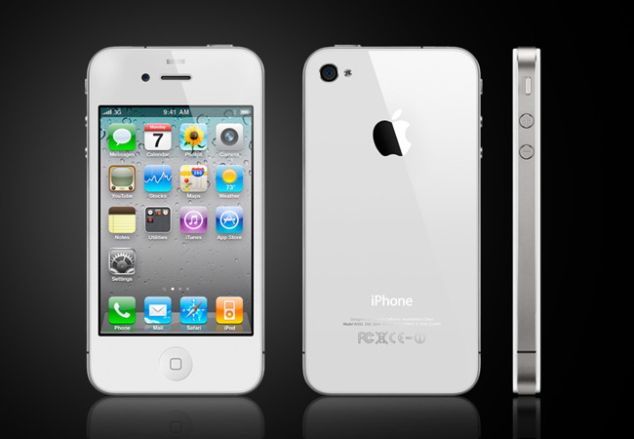
NEW TO THE TOUCH
When Steve Jobs first demonstrated “the pinch”—the two-finger gesture for zooming in and out of photos and Web pages on the iPhone, he not only shook up the mobile phone industry—the entire digital world took notice. The Apple iPhone’s multitouch features dramatized new ways of using touch to interact with software and devices.

Slide 3
NEW TO THE TOUCH
What Apple did was to make multitouch more exciting and relevant, popularizing it just as it did in the 1980s with the mouse and the graphical user interface. (These had also been invented elsewhere.)

Slide 4
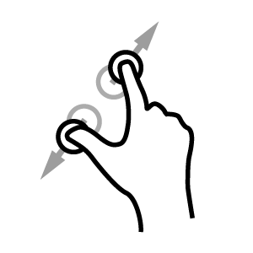
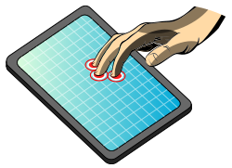
NEW TO THE TOUCH
Multitouch interfaces are potentially more versatile than single-touch interfaces. They allow you to use one or more fingers to perform special gestures that manipulate lists or objects on a screen without moving a mouse, pressing buttons, turning scroll wheels, or striking keys.

Slide 5
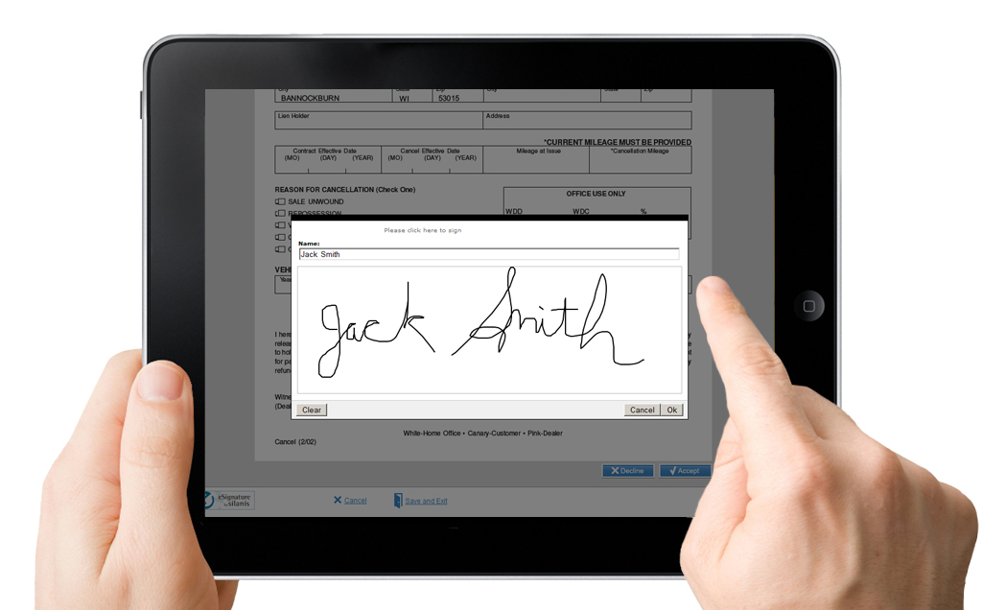
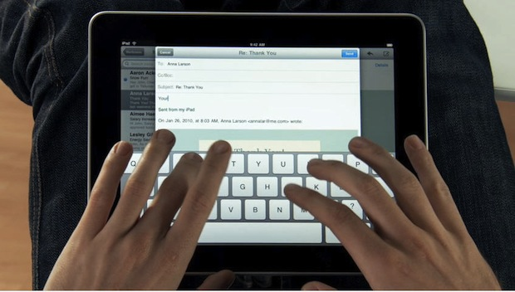
NEW TO THE TOUCH
Apple has made a concerted effort to provide multitouch features in all of its product categories, but many other consumer technology companies have adopted multitouch for some of their products.Synaptics, a leading supplier of touchpads for laptop makers who compete with Apple, has announced that it is incorporating several multitouch features into its touchpads.

Slide 6
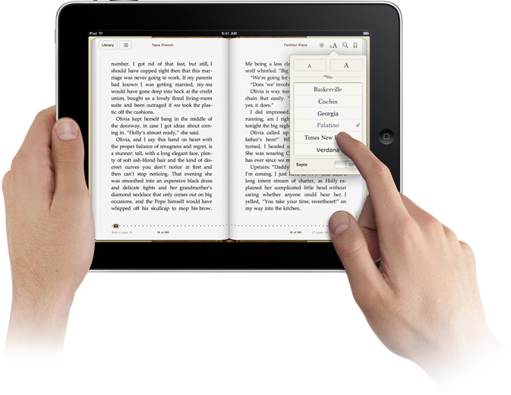
NEW TO THE TOUCH
Microsoft’s Windows 7 operating system sports multitouch features: When you pair Windows 7 with a touch-screen PC, you can browse online newspapers, flick through photo albums, and shuffle files and folders using nothing but your fingers

Slide 7
NEW TO THE TOUCH
It’s too early to know if the new multitouch interface will ever be as popular as the mouse-driven graphical user interface. Although putting ones fingers on the screen is the ultimate measure of “cool” in the cell phone market, a “killer application” for touch on the PC has not yet emerged. But it’s already evident that touch has real advantages on devices where a Mouse isn’t possible or convenient to use, or the decades-old interface of menus and folders is too cumbersome.

Slide 8
Case Study Questions
1. What problems does multitouch technology solve?
1. - Helps people with disabilities - Helps autistic students to speak to and communicate with others.
- Replace the use of mouse and keyboard - For users who cannot grasp a mouse and want the functionality of a PC. (e.g the Dell Latitude XT tablet.)
- Minimize clutter with portable device - Such as the Android operating systems for smartphones has support for multi-touch. Users can manage emails, contacts, calendars and hold virtual meetings through a built-in webcam and microphone.

Slide 9
NEW TO THE TOUCH
2- What are the advantages and disadvantages of a multitouch interface? How useful is it? Explain
Advantages :
Extremely good for object manipulations - Touch, drag, “pinch” to zoom in and out, slide finger up and down or sideways as if they were physical objects without moving a mouse, pressing buttons or striking keys. For example, Perceptive Pixel offers pressure-sensitive multi-touch displays that can sense an unlimited number of simultaneous touches with accuracy and precision.

Slide 10
NEW TO THE TOUCH
2. More versatile than single-touch interfaces - as opposed to the single-touch screen, which recognizes only one touch point. Multitouch interface allows one or more fingers to perform gestures to manipulate objects.
3. Collaborative use - before the multitouch technology was invented, even with computer display connected to an external projector and another mouse, it was impossible for more than one person to make edits when pulling together a PowerPoint presentation

Slide 11
NEW TO THE TOUCH
Disadvantages :
Hands on
Handheld devices that rely on touch screens for input require two hands to operate: one to hold the device and the other to operate it. Thus, operating them generally requires both eyes and both hands. Unlike the usual phones that can be operated and held using one hand: one hand to hold the device and a finger of the same hand to operate it

Slide 12
NEW TO THE TOUCH
Fingers on
Your finger is not transparent: the smaller the touch screen, the more you obscure what is being pointed at. That is why a stylus or pointer should be used: it is very skinny and accurate in such a way that nothing on the screen gets obscured
Prices
Prices of such devices might be too high at the beginning as it is for every new emerging technology. That might be a disadvantage and people might refrain to buy it and be afraid to try new stuff but eventually prices will continually decrease year after year until the product reaches every customer it can in order to spread the new technology

Slide 13
NEW TO THE TOUCH
Eyes on
Touch screen interfaces are nearly all “eyes on”. You cannot type by touch while your eyes are occupied elsewhere like most cases of 12-17 year old kids than can text and type without looking. With an all touch-screen interface you generally cannot start, stop, or pause your MP3 player, for example, or close and answer your phone by reaching into your pocket, purse, or briefcase like you usually do since you don't have a one mechanical key to memorize it's location and operate eyes free. This risks serious accidents for example if someone tries to operate a multi touch car radio while driving

Slide 14
NEW TO THE TOUCH
3. Describe three business applications that would benefit from a multitouch interface.
i. Mobile applications
Tools for sales teams, technicians, medical staff, logistics tracking, banking, insurance, and teaching: professional mobile apps are popping up in all industry sectors, particularly for tablets.

Slide 15
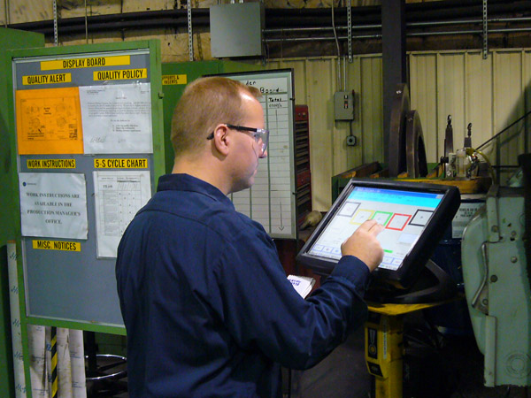
NEW TO THE TOUCH
ii. The long-neglected office-based workers
Touch-screen devices are huge at the moment: tablets enhance users’ image and are ideal for mobile staff and executives.The future will doubtless see an increase in interactive desks, i.e. touch-screen features but copied onto a physical desk, with all the advantages of interactive, paperless functions.

Slide 16
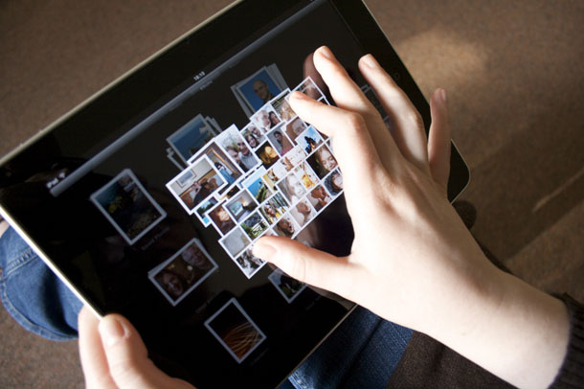
NEW TO THE TOUCH
iii. Reading digital material (e-books/ e-mail) :
Supported with pinch zoom function
Easily to drag or double click
QWERTY onscreen keyboard that supported multi touch for 2 handed typing

Slide 17
NEW TO THE TOUCH
What management, organization, and technology issues must be addressed if you or your business was considering systems and computers with multitouch interfaces?
Management : Cost, technology adoption, training, business objective
Organization : Structure and capability
Technology : Fast server, system ready for use, better serve, permanent hardware

Slide 18

MIS IN ACTION
1. Describe what you would do differently on your PC if it had multitouch capabilities. How much difference would multitouch make in the way you use your computer?

Slide 19
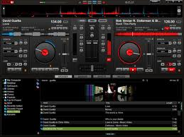
NEW TO THE TOUCH
If my PC had multitouch capabilities I would download countless virtual DJ
software. The [laptop] PC I have now is barely mobile and constant clicking
internally and externally (program wise) makes mixing and playing music through most software pretty difficult. And now companies are releasing DJ software exclusively for multitouch interfaces to seamlessly cross fade and mix music. It would make an incredible difference in the way I use my computer because I mainly use my computer for musical purposes; I would have so much more potential in the way I engaged in DJ software.

Slide 20
THANK YOU ALL!!!
ANY QUESTIONS?
karaoglu.bora@yahoo.com
salamios@yahoo.com
ambspecial@hotmail.co.uk

